Slide 1


Slide 2
Agenda
Welcome!
Data Engineering Overview
Setup and Homework for next week

Slide 3
Welcome!
Thank you for joining us!
What is your name?
Tell us something about you
What do you want to get out of this class?
Notes:
Videography release form
Book
Udemy classes
IDE (intellij)
Access to google classroom materials
Stretch: Kafka binaries
Super stretch: Connect to GCP kafka
Super super stretch: Connect to GCP dataproc cluster

Slide 4
Class Structure
Schedule
6:00 PM - Class Instruction / Food
Doors to the outside are locked so it is important to be on time
7:00 PM - Lab time - pair programming & work time
Different skill levels
Google Classroom - https://tinyurl.com/1904class
Things to bring
Laptop

Slide 5
Materials for the Class
Hadoop - The Definitive Guide 4th Edition
Kafka Udemy Class https://www.udemy.com/course/apache-kafka/
Python Spark Class or Scala Spark Class https://www.udemy.com/course/taming-big-data-with-apache-spark-hands-on/ https://www.udemy.com/course/apache-spark-with-scala-hands-on-with-big-data/

Slide 6
Today’s Class
Intro to Data Engineering
Lab time
Hand out materials
Get your development environment setup
Kafka Install/Setup
Homework
Watch videos in Kafka Udemy Course
Notes:
Videography release form
Book
Udemy classes
IDE (intellij)
Access to google classroom materials
Stretch: Kafka binaries
Super stretch: Connect to GCP kafka
Super super stretch: Connect to GCP dataproc cluster

Slide 7

Intro to Data Engineering
Hours with Experts 2020 - Week 01

Slide 8
A Brief History of Data
Relational DBs
Big Data
Operational systems built with SQL
Data Lakes, Hadoop, NoSQL, distributed file systems.
Files
Data Warehouses
Cloud
Data in Excel, XML, CSV, JSON or mainframes
Many systems feeding MPP systems
Separate storage and compute, pay as you go.
Notes:
MPP - Massively Parallel Processing
SQL - Structured Query Language
NoSQL - Literally No SQL or “Not Only SQL”. Examples include key/value stores like Redis, wide column dbs like Cassandra and HBase.
First there was files. Files as far as the eye could see. Data in CSV and XML. Then Excel came along. If you were fancy you had mainframes.
Then came the relational database renaissance. Everyone writes SQL and puts all their data in Oracle, MySQL, PostgreSQL, or SQL Server.
Next people wanted to consolidate all their data into a Data Warehouse. MPP platforms like Teradata, Netezza, and Oracle DW.
Hadoop burst onto the scene with cluster computing. Hadoop distributed file system. Map Reduce
Cloud offered a new way with managed services. Separation of storage and compute.

Slide 9
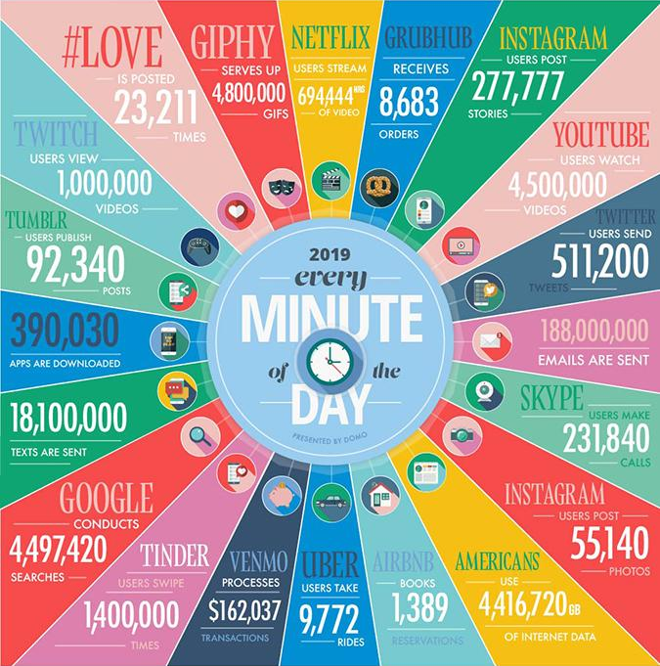
Source: Domo’s Data Never Sleeps 7
Notes:
Internet usage over the past few years has exploded resulting in

Slide 10
The V’s of Big Data
Volume - quantity of data, too much for one machine
Variety - tweets, videos, iot, databases, logs
Velocity - batch, streaming from many devices
Variability - meaning of data changes, ex: sentiment
Veracity - data quality, accuracy
Notes:
Volume - The quantity of generated and stored data. The size of the data determines the value and potential insight- and whether it can actually be considered big data or not.
Variety - The type and nature of the data. This helps people who analyze it to effectively use the resulting insight.
Velocity - In this context, the speed at which the data is generated and processed to meet the demands and challenges that lie in the path of growth and development.
Variability - Inconsistency of the data set can hamper processes to handle and manage it.
Veracity - The quality of captured data can vary greatly, affecting the accurate analysis

Slide 11
Why Data Engineering?
More data, coming in faster than ever
Data is more valuable
Used in all areas of the business to drive decisions
Technology is more complex
Relational Databases (SQL), NoSQL, Graph databases, Hadoop, Cloud, Stream processing frameworks, Distributed file systems, File formats like Avro or Parquet, Data warehousing, data modeling, data governance

Slide 12
49
Total number of projects on the Apache Software Foundation “Big Data” list
Not counting Apache Hive, Apache HBase, Apache ZooKeeper + others!

Slide 13
Hot Takes
What makes a “good” data engineer?
Solid software engineering foundation (python or java based)
Focus on automation and testing
Knowledge of a variety of databases/stores
SQL and NoSQL
File formats
Distributed systems
Code > tools
Open source
Ability to learn
Notes:
A data engineer should have a solid software engineering foundation. This involves using version control, collaborating with a team
Working with DevOps engineers to deploy and test code in an automated way. Using Jenkins.
Having knowledge of a variety of different databases and data stores. Knowledge of SQL is not enough! Relational databases are a powerful tool but they aren’t the only tool.
I prefer writing code to using tools. However the data space is gigantic and there are a lot of tools out there - ETL tools like informatica and SAS. Code is testable and diffable

Slide 14
Responsibilities as a Data Engineer
Requirements gathering
Lineage
Security and governance
Data storage
Processing AKA extract, transform and load (ETL)
https://www.dremio.com/what-is-data-engineering/
Notes:
Gathering data requirements, such as how long the data needs to be stored, how it will be used, and what people and systems need access to the data.
Maintaining metadata about the data, such as what technology manages the data, the schema, the size, how the data is secured, the source of the data, and the ultimate owner of the data.
Ensuring security and governance for the data, using centralized security controls like LDAP, encrypting the data, and auditing access to the data.
Storing the data, using specialized technologies that are optimized for the particular use of the data, such as a relational database, a NoSQL database, Hadoop, Amazon S3, or Azure Blog Storage.
Processing data for specific needs, using tools that access data from different sources, transform and enrich the data, summarize the data, and store the data in the storage system
TODO: In this class we are only dealing with #4 and #5

Slide 15
Who is the Data Engineer working with?
Product Owner / Stakeholders
Data Analysts
System Architects
Data Scientists
https://www.dremio.com/what-is-data-engineering/
Notes:
Product Owner / Stakeholders - the business person who is paying the bills and knows the value of what you’re building.
Data Analysts - the technical person who knows the deep, dark secrets of the data store you’re working with
System Architects - the guy plugging all of the complex infrastructure together into one system
Data Scientists - answering very complex questions, creating models and making predictions
TODO: Ask the room, does everyone understand the difference between DE and DS? Include a slide in case

Slide 16
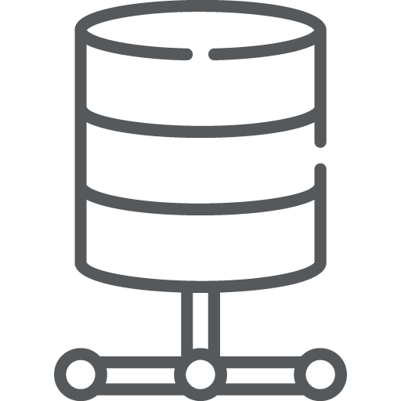

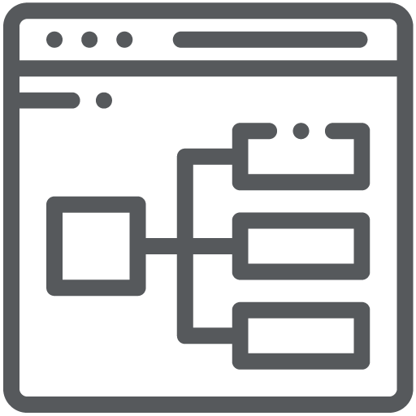



What are we doing in this class?
Hive
HBase
HDFS
Kafka
Spark
Notes:
In this class we will be building a streaming data pipeline from end to end. We will learn about each component
Stream data from Kafka into Spark.
Enrich the stream using data stored in HBase.
Write the data to the Data Lake where we will query it with Hive.
Use case: ecommerce or movies

Slide 17
Apache Kafka
Publish-subscribe messaging for streaming data
Installed on a cluster, data stored locally on disk
Core concepts:
Topics - stream of records (key, value) stored in order split up across partitions
Producer - puts data on topics
Consumer - read data off topics
Data is not removed once a consumer reads it like a traditional MQ
Data is retained for a fixed amount of time
Consumers can read data from a given offset
Using Kafka:
Client APIs to produce/consume data
Command line utilities for debugging
Notes:
Q: Poll audience, who has used this?

Slide 18
Apache Spark
Framework for batch and streaming (micro-batch) distributed data processing
Modules:
Spark SQL for SQL and structured data processing
Spark Streaming
MLib for machine learning
GraphX for graph processing
Using Spark
Write a Spark application using Java, Scala, or Python APIs, then “submit” the application to the cluster
Python: Use pyspark, a python REPL - (read-eval-print-loop)
Scala: Use spark-shell (a scala REPL)
Notebooks: Jupyter, Zeppelin
Notes:
Q: Poll audience, who has used this?

Slide 19
Apache HBase
NoSQL data store on HDFS
key/value store
Schema-less
Optimized for random reads
Data is partitioned by key across a cluster
Large datasets - billions of rows, millions of columns
Using HBase:
Java/REST APIs
HBase shell for interactive queries
Notes:
Q: Poll audience, who has used this?

Slide 20
Apache Hadoop - Hadoop Distributed File System (HDFS)
Store data across many machines
Designed to store large files
Files are split into blocks
Blocks are replicated across different nodes in the cluster
Many other Hadoop projects store their data in HDFS
Using HDFS
Indirectly via other services (Hive, HBase, Spark, etc)
Access it directly using the command line:
hdfs dfs -help
hdfs dfs -ls
hdfs dfs -mkdir /tmp/something
Notes:
Q: Poll audience, who has used this?

Slide 21
Apache Hive
Query files in HDFS with “SQL”
Schema on read
Supports a variety of file formats:
Plain text: CSV, TSV
Columnar file formats: ORC, Parquet
Avro
JSON
Using Hive
Command line with Hive from the edge node
Web UI like Hue
Notes:
Q: Poll audience, who has used this?

Slide 22
Lab time

Slide 23
Lab Time & Homework
Lab time
Fix classroom https://tinyurl.com/1904class
Hand out materials
Get your development environment setup
Kafka Install/Setup
Homework
In the Kafka Udemy Course, watch Sections 1-6
Next week, we will work on section 7 during lab time
Linux
export BOOTSTRAP_SERVERS=35.208.65.122:9092,34.68.16.1:9092,35.225.151.65:9092
bin/kafka-console-consumer.sh --bootstrap-server $BOOTSTRAP_SERVERS --topic dehwe --from-beginning
Windows
SET BOOTSTRAP_SERVERS=35.208.65.122:9092,34.68.16.1:9092,35.225.151.65:9092
windows/kafka-console-consumer.bat --bootstrap-server %BOOTSTRAP_SERVERS% --topic dehwe --from-beginning
Powershell
$Env:BOOTSTRAP_SERVERS = "35.208.65.122:9092,34.68.16.1:9092,35.225.151.65:9092"
.\bin\windows\kafka-console-consumer.bat --bootstrap-server $Env:BOOTSTRAP_SERVERS --topic dehwe --from-beginning

